Slide 1
Georeferencing Concepts

Slide 2
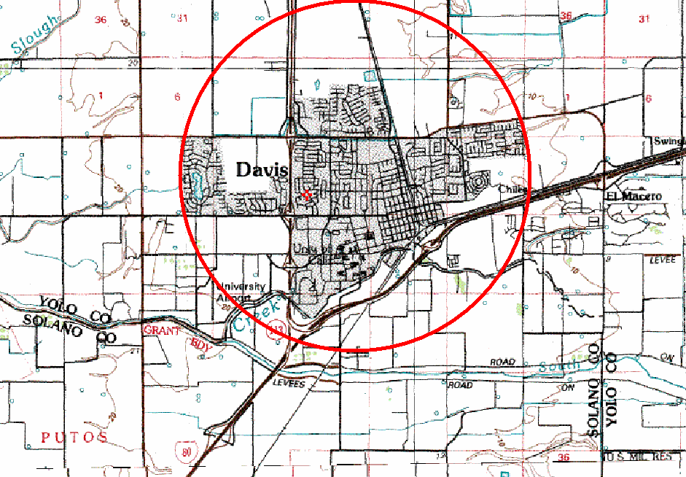
Georeferencing Concepts
Named place: a place of reference in a locality description. Example: “Davis” in “5 mi N of Davis”
Extent- the geographic range, magnitude or distance that a location may actually represent. (With a town, the extent is the polygon that encompasses the area inside the town’s boundaries.)
Linear extent- what we use for the Point-Radius Method. Defined as the distance from the geographic center of the location to the furthest point of the geographic extent of the location. This is used in the Georef. Calculator to determine Maximum Error.

Slide 3
Georeferencing Concepts
coordinateUncertaintyInMeters: “The horizontal distance (in meters) from the given decimalLatitude and decimalLongitude describing the smallest circle containing the whole of the Location. Leave the value empty if the uncertainty is unknown, cannot be estimated, or is not applicable (i.e., there are no coordinates). Zero is not a valid value for this term.” (from Darwin Core)
Maximum Error Distance: same as coordinateUncertaintyInMeters, except the units are the same as in the locality description, not necessarily in meters.

Slide 4
Georeferencing Using
MaNIS/HerpNET/ORNIS Guidelines
Parallels of
Meridians of
Graticular
Latitude
Longitude
Network

Slide 5
MaNIS/HerpNET/ORNIS (MHO) Guidelines http://manisnet.org/GeorefGuide.html
uses point-radius representation of georeferences
circle encompasses all sources of uncertainty about the location
methodology formalizes assumptions, algorithms, and documentation standards that promote reproducible results
methods are universally applicable

Slide 6
Data Quality
data have the potential to be used in ways unforeseen when collected.
the value of the data is directly related to the fitness for a variety of uses.
“as data become more accessible many more uses become apparent” – Chapman 2005
the MaNIS/HerpNET/ORNIS guidelines follow best practices (Chapman and Wieczorek 2006) to enhance data quality and value

Slide 7
Georeferencing Using
MaNIS/HerpNET/ORNIS Guidelines

Slide 8
Locality Types: Named Place
Named Place – Used to refer to traditional and non-traditional features (towns, cities, mountains, ranches, highway mile markers, townships, intersections). Use geographic center for the coordinates.
Example with shaded urban area: Davis, California
Linear extent- Defined as the distance from the geographic center of the location to the furthest point of the geographic extent of the location. We plug this value in the Georef. Calculator to determine Maximum Error.

Slide 9
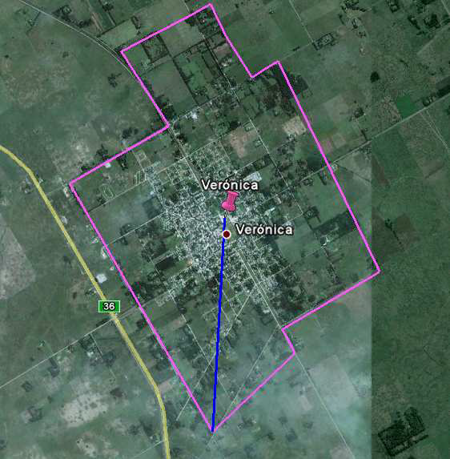
Locality Types:
Named Place - Urban Area
Locality consists of a reference to a geographical feature having a spatial extent, example “Veronica,
Argentina”
If the geographic center does not fall within the shaded urban area, choose the nearest point to the center within the shape.

Slide 10
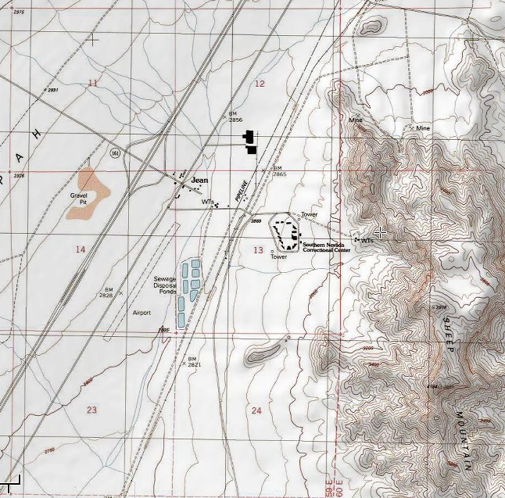
Named Place – Small town
Example: Jean, Nevada

Slide 11
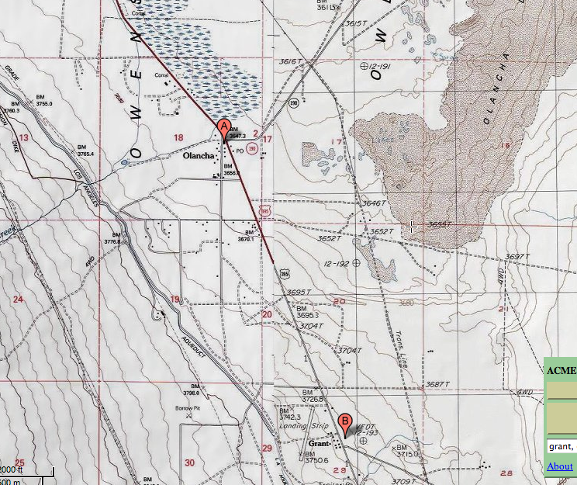
Named Place – Remote
A locality that does not have a clear boundary on the map.
Olancha, California
Extent is half the distance to the center of the next nearest named place (or feature), which is Grant, CA.

Slide 12
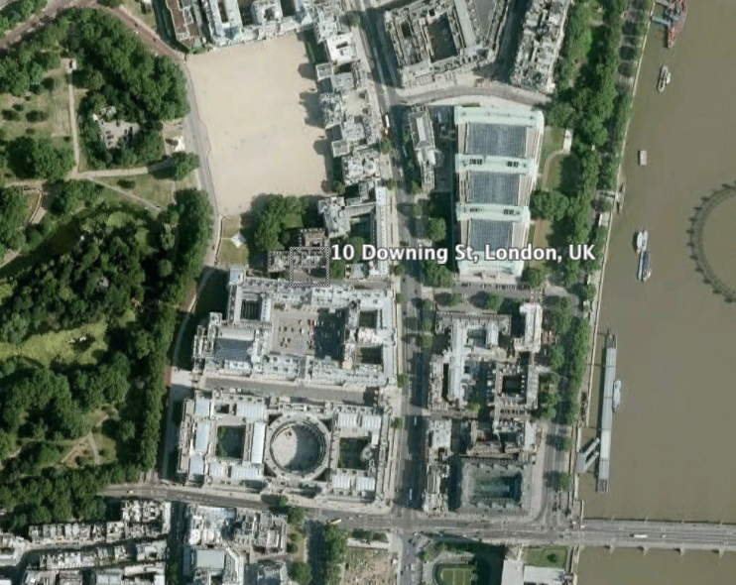
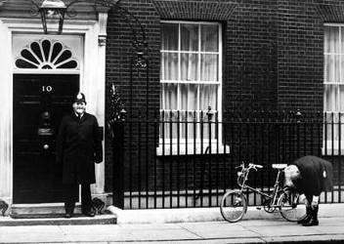
Locality Types:
Named Place – Street Address
No.10 Downing St., London, England
Extent is the smallest area possible that cannot be mistaken for another address, sometimes one half a city block.

Slide 13
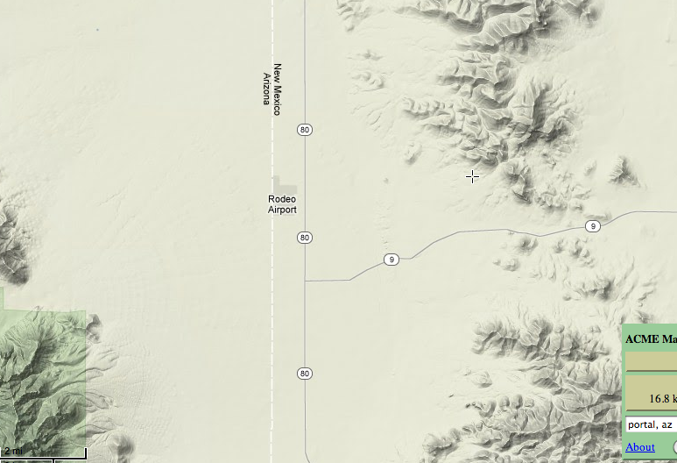
Named Place – Junction
Junction of Hwy 80 and Hwy 9, Hidalgo, New Mexico
Measure the extent of the junction as if it were a named place. Use the following standards for extent:
10 m for two lane city street or highway,
20 m for four lane highway
30 m for large highways with medians

Slide 14
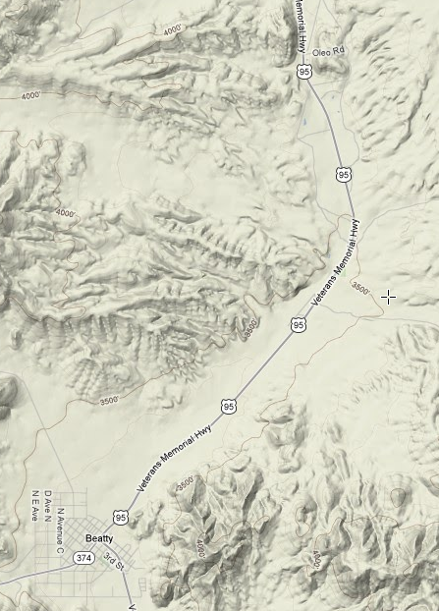
Offsets:
5 miles north of Beatty on US 95
Distance from a named place using the center of the named place as a starting point. Used with a heading to give direction and distance from named place.
Georeference an offset on a river or path the same way as a road.
Example: 5 miles North of Beatty (on US 95), Nevada
This incorporates error from distance precision and extent, but not direction

Slide 15
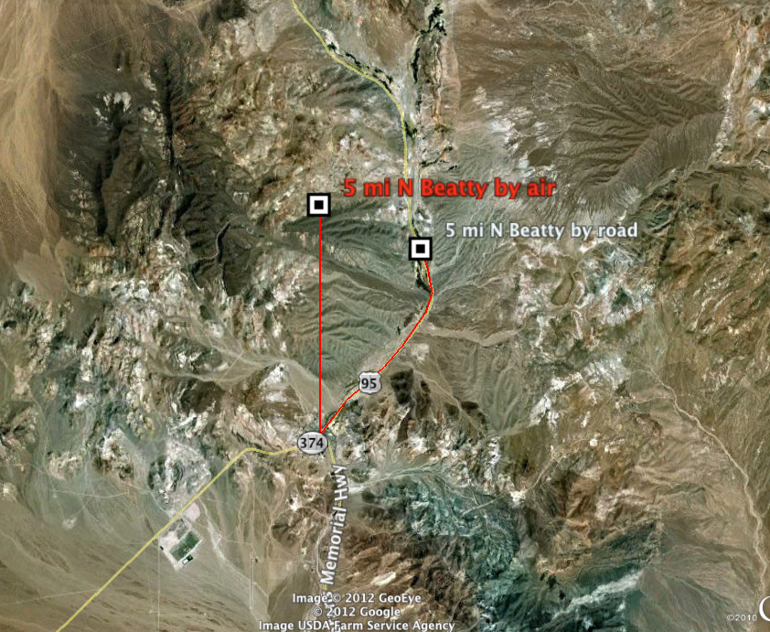
Comparing Offsets and Errors
Max error by air is 4.95 miles, by road is 2 miles

Slide 16
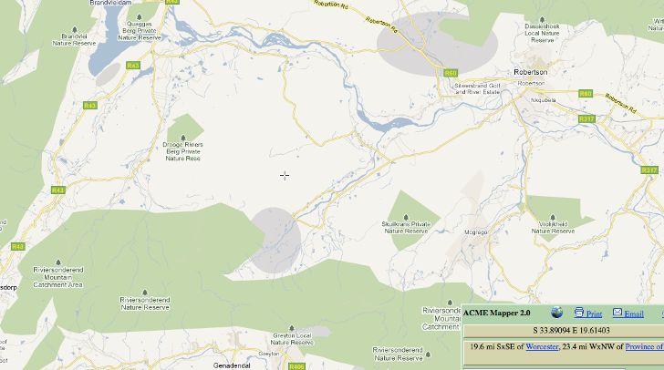
Locality Type: Named Place Between Two Localities
Between two places is treated as a type of named place, where the georeference is the midpoint between the centers of both named places.
Example: Between Drooge Riviers Berg Private Nature Reserve and Skulkrans Private Nature Reserve, Province of the Western Cape, South Africa.

